Slide 1

Date:- 18/10/2021
Project Title | P75- Summary Extraction along with sentiment analysis.
Team Members | Manan Malhotra
 | Nandini Reddy
 | Renu Rawat
 | Rohit Pawar
 | Shubham Patel
Project Guide | Mr. Parth Sagar
Summary Extraction Along With Sentiment Analysis

Slide 2
Business Problem:
Business Objective : P75- Summary Extraction along with sentiment analysis.
Objective:
To extract E-books of your choice and extract summary, categorize summary as positive, negative or neutral. Build a NLP model to achieve the said objective with accepted accuracy of 75% and above.

Slide 3
Exploratory Data Analysis
Why EDA ?
Exploratory Data Analysis refers to the critical process of performing initial investigations on data so as to discover patterns, to spot anomalies, to test hypothesis and to check assumptions with the help of summary statistics and graphical representations.

Slide 4
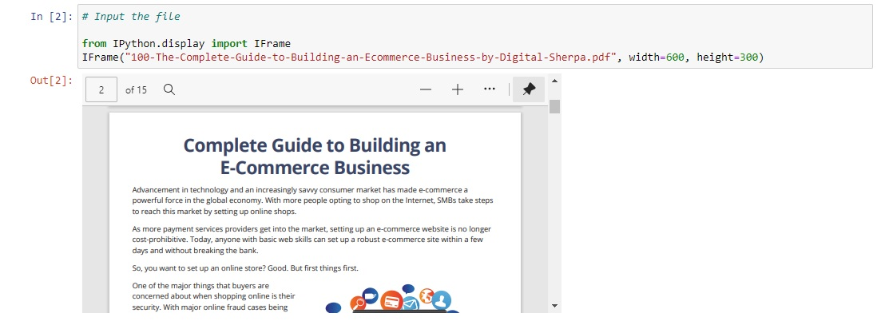
DATA SET

Slide 5
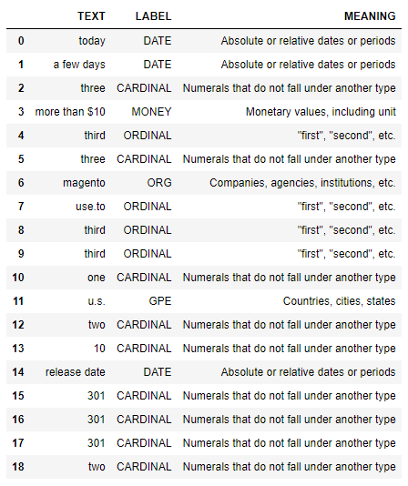
NAMED ENTITY RECOGNITION

Slide 6
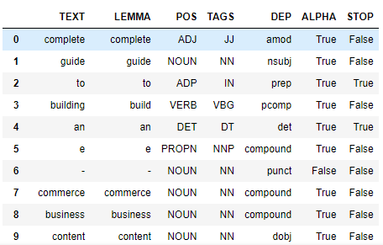
parts of speech & dependency

Slide 7
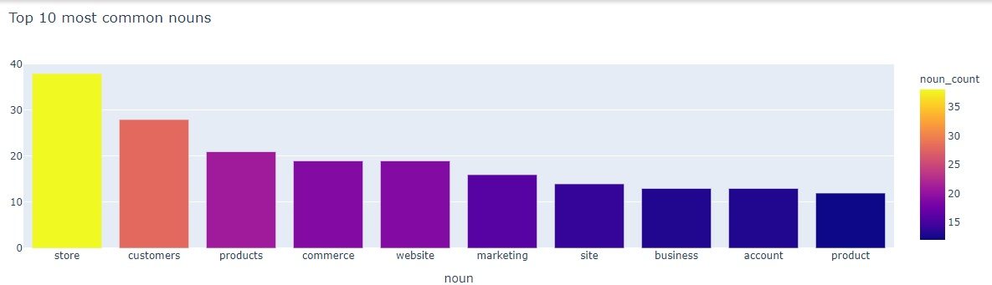
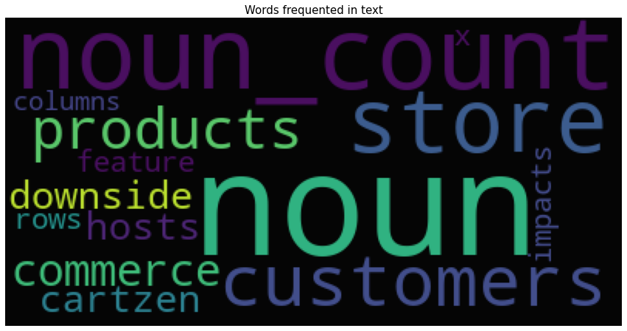
Noun extraction

Slide 8
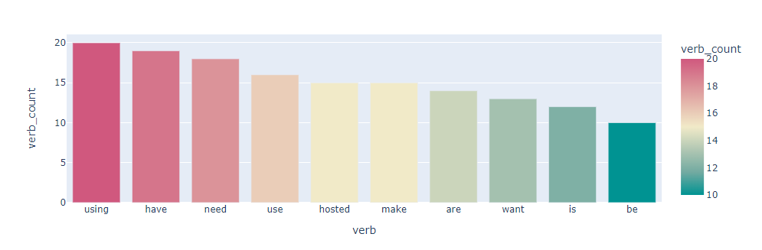
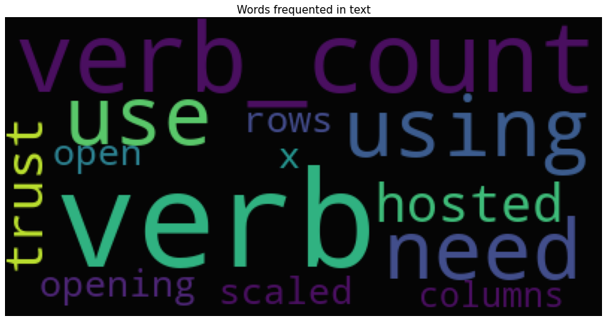
Verb Extraction

Slide 9
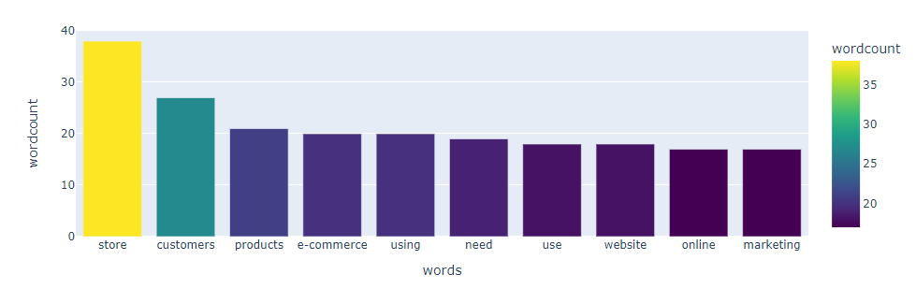
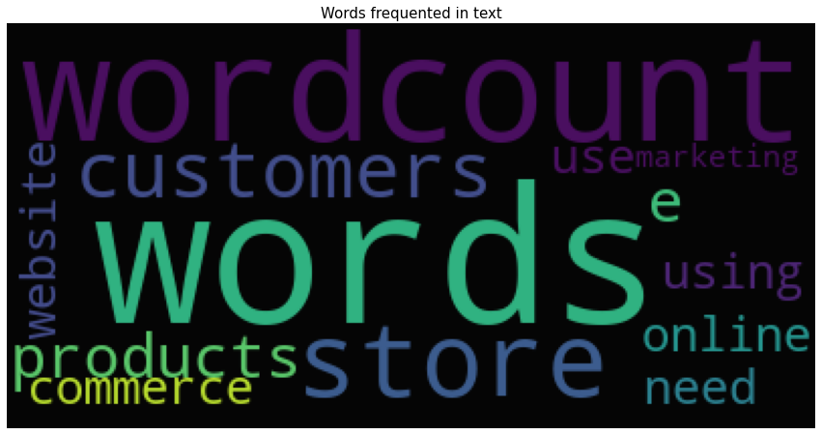
WORD COUNT

Slide 10
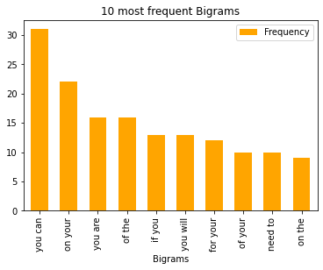
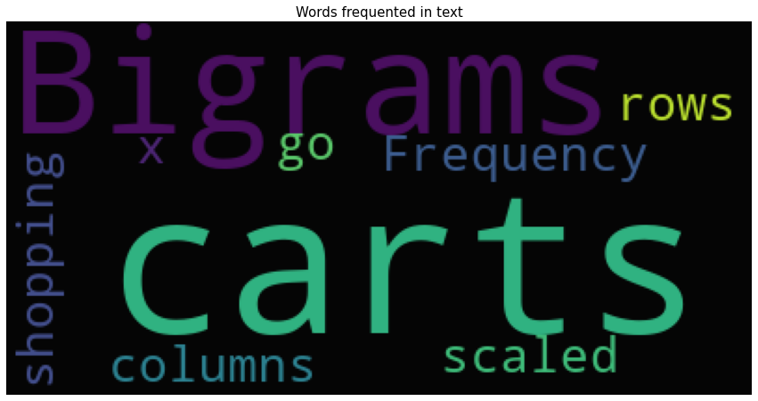
Bigrams

Slide 11
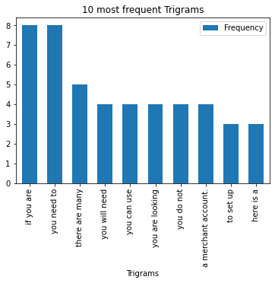
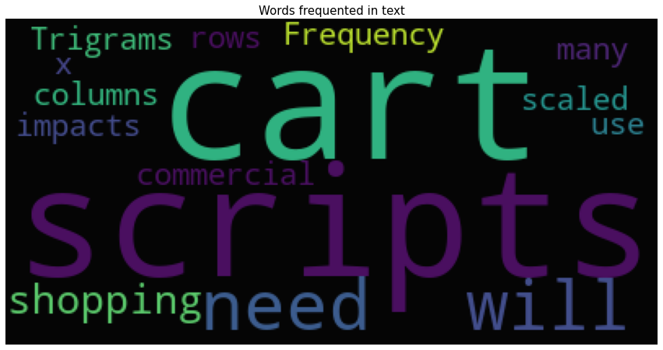
Trigrams

Slide 12

Model Building

Slide 13
Template for Model results presentation
Data set details
Pre Trained Models
Ecommerce_Business_Guide.pdf
Algorithm details and configuration
Data Partition details
Sumy summarizers for Extractive
Corpus
transformer summarizers for Abstractive
Trained Models
Spacy- Word Frequency
TF-IDF

Slide 14
Model Results
Example
Model generated the output for ebook that was summarized within 5 sentences using different pre-defined summarizers which were abstractive and extractive. Modules that were imported were sumy and transformer.
After that we trained our models using Spacy-word frequency and TF-IDF and were able to generate the summary from our E-book.

Slide 15
Types of pre trained summarizers Used
LexRank Summarizer
Luhn Summarizer
LSA Summarizer
TextRank Summarizer
Edmundson Summarizer
Reduction Summarizer
T5 Summarizer

Slide 16
LexRank Summarizer
LexRank is an unsupervised approach that gets its inspiration from the same ideas behind Google’s PageRank algorithm. The authors say it is “based on the concept of eigenvector centrality in a graph representation of sentences”, using “a connectivity matrix based on on intra-sentence cosine similarity.” Ok, so in a nutshell, it finds the relative importance of all words in a document and selects the sentences which contain the most of those high-scoring words.

Slide 17
Luhn Summarizer
One of the first text summarization algorithms was published in 1958 by Hans Peter Luhn, working at IBM research. Luhn’s algorithm is a naive approach based on TF-IDF and looking at the “window size” of non-important words between words of high importance. It also assigns higher weights to sentences occurring near the beginning of a document.

Slide 18
LSA Summarizer
Latent Semantic Analysis is a relatively new algorithm which combines term frequency with singular value decomposition.

Slide 19
TextRank Summarizer
TextRank is another text summarizer based on the ideas of PageRank, and was also developed at the same time as LexRank, though by different groups of people. TextRank is a bit more simplistic than LexRank; although both algorithms are very similar, LexRank applies a heuristic post-processing step to remove sentences with highly duplicitous.

Slide 20
Edmundson Summarizer
In 1969, Harold Edmundson developed the summarizer bearing his name. Edmundson’s algorithm was, along with Luhn’s, one of the seminal text summarization techniques. What sets the Edmundson summarizer apart from the others is that it takes into account “bonus words”, words stated by the user as of high importance; “stigma words”, words of low importance or even negative importance; and “stop words”, which are the same as used elsewhere in NLP processing. Edmundson suggested using the words in a document’s title as bonus words. Using the chapter title as bonus words, this is what Edmundson outputs:

Slide 21
Reduction Summarizer
The Reduction algorithm is another graph-based model which values sentences according to the sum of the weights of their edges to other sentences in the document. This weight is computed in the same way as it is in the TexRank model.

Slide 22
T5 Summarizer
T5 or Text-to-Text Transfer Transformer is a model from Google that is trained in an end-to-end manner with text as input and modified text as output. T5 is an abstractive summarization algorithm. It means that it will rewrite sentences when necessary than just picking up sentences directly from the original text.

Slide 23
Types of trained models for summarization Used
Spacy- word frequency
TF-IDF

Slide 24
Extractive Summarization – Using Spacy - word frequency
Text cleaning- Removal of stop words, punctuations, marks and making lower case.
Word Tokenization- Tokenizing each word
Word frequency Table- Normalizing word frequency count
Sentence scoring- Calculate most important sentences by adding word frequencies.
Generating summary- Using largest function from heapq library.

Slide 25
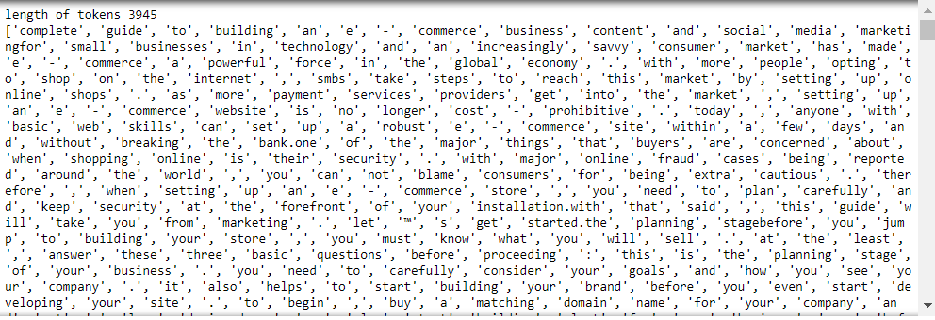
Word Tokens

Slide 26
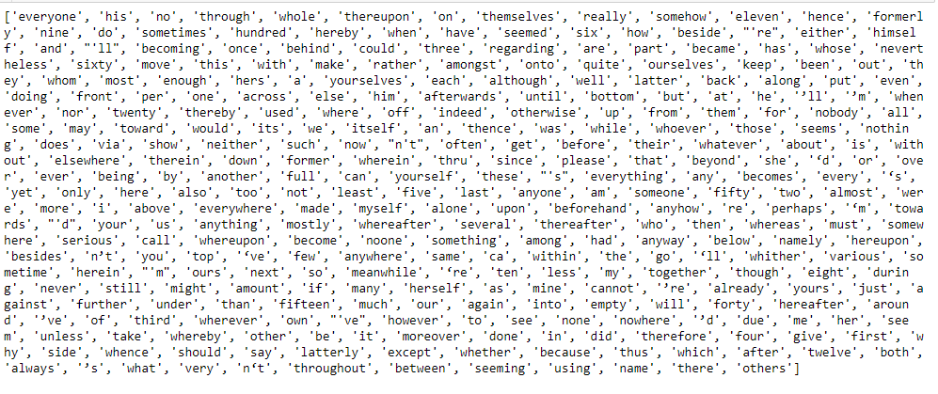
Spacy Stopwords

Slide 27
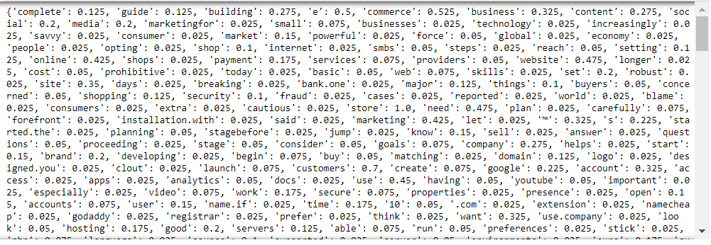
Words Frequencies

Slide 28
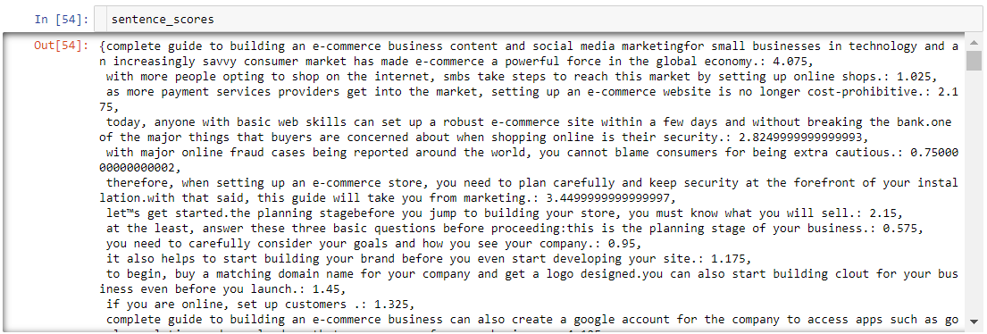
Sentence Score

Slide 29
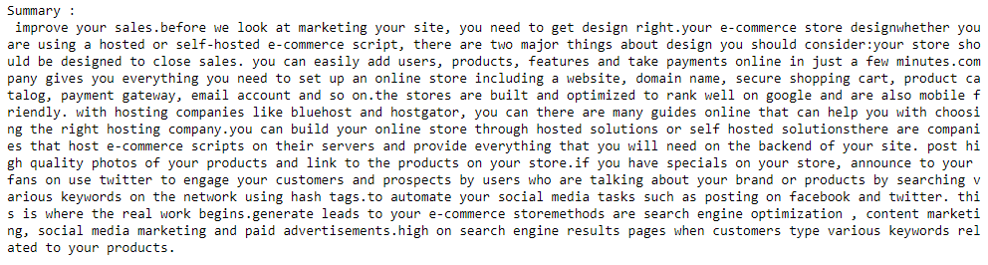
Summary

Slide 30
Extractive Summarization - TF-IDF
TF-IDF (term frequency-inverse document frequency) is a statistical measure that evaluates how relevant a word is to a document in a collection of documents.
It is done by multiplying two metrics: how many times a word appears in a document, and the inverse document frequency of the word across a set of documents.
It has many uses, most importantly in automated text analysis, and is very useful for scoring words in machine learning algorithms for Natural Language Processing (NLP).

Slide 31
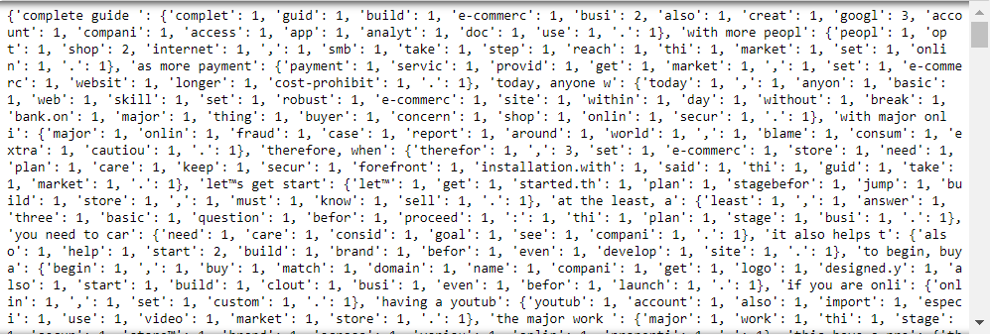
Frequency Matrix

Slide 32
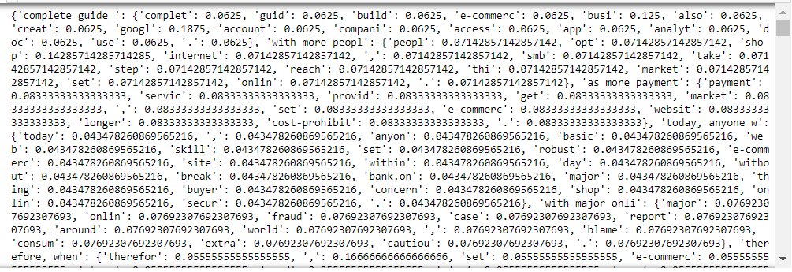
TF Matrix

Slide 33
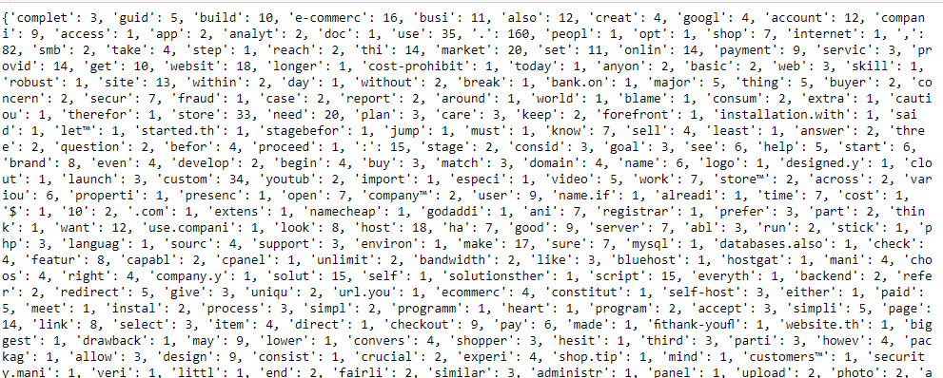
Words per document

Slide 34
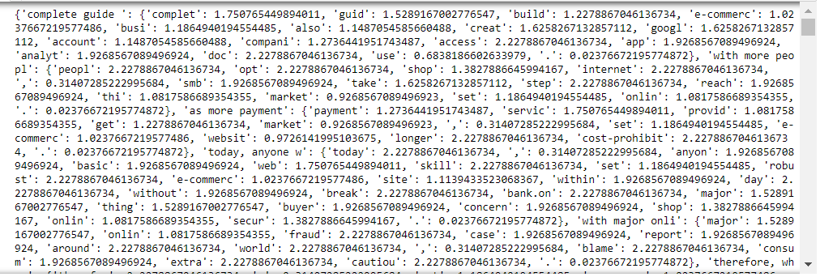
IDF Matrix

Slide 35
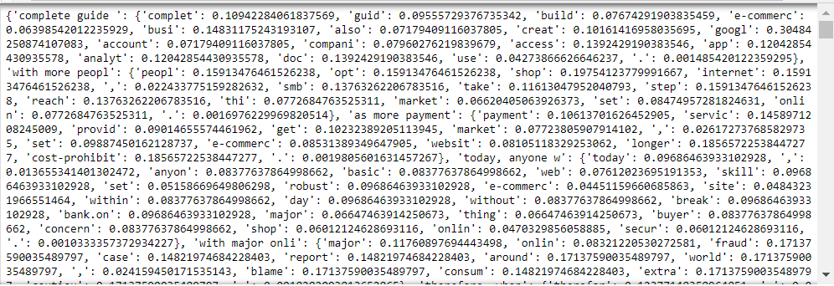
TF-IDF Matrix

Slide 36
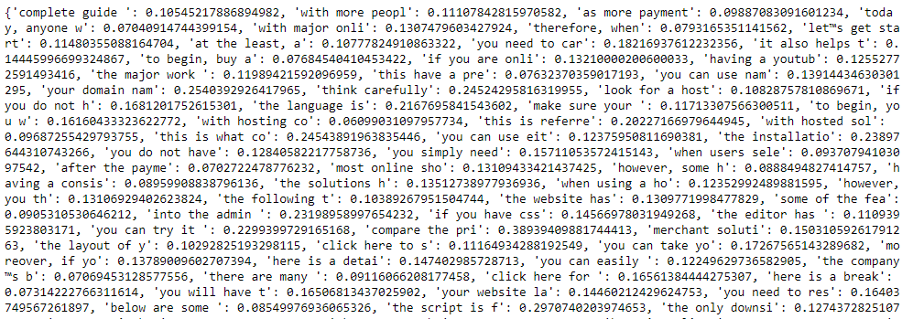
Sentence Scoring

Slide 37
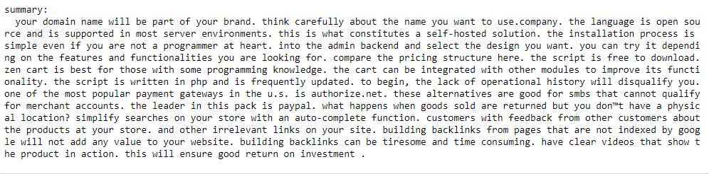
Summary Generated

Slide 38
Thank you

